Slide 1
Binary Shifts
A shift involves moving the bits stored in a register a given number of places within the register.
Each bit within the register may be used for a different purpose.
Example in the IR each bit identifies a different interrupt.

Slide 2
Binary Shifts
Types of shifts
Logical
Arithmetic
Cyclic Shifts

Slide 3
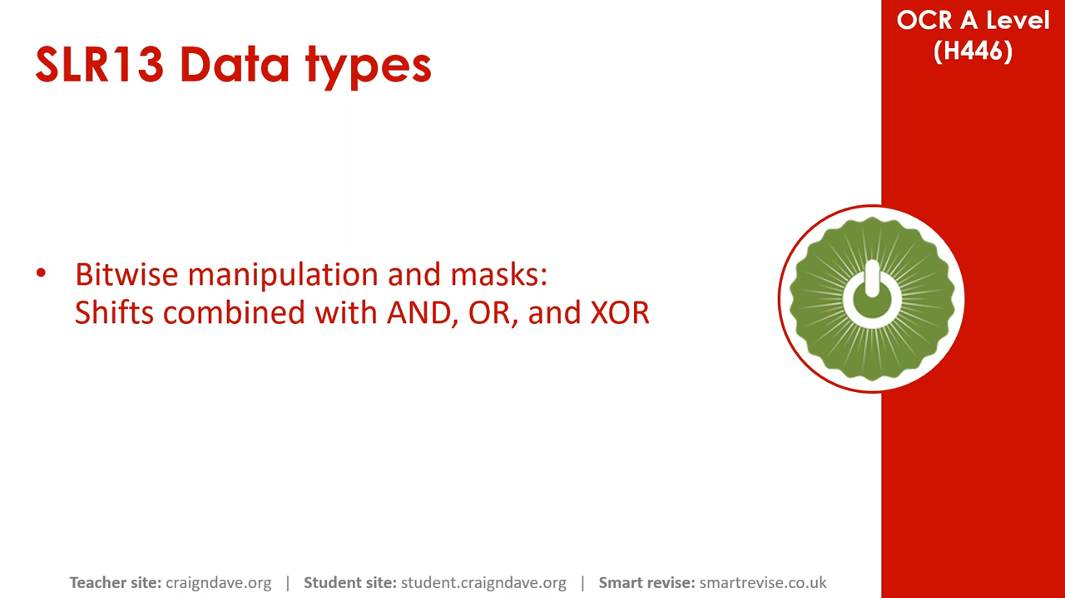
video

Slide 4
Logical & Arithmetic Left Shift
Logical
Arithmetic
Each bit is moved one left
The most significant bit(left most) is discarded
A zero is added to the right
repeat for the number of shifts required...
1 | 0 | 1 | 1 | 0 | 1 | 0 | 1

Slide 5
Logical & Arithmetic Left Shift
Logical
Arithmetic
Each bit is moved one left
The most significant bit(left most) is discarded
A zero is added to the right
repeat for the number of shifts required...
1 | 0 | 1 | 1 | 0 | 1 | 0 | 1

Slide 6
Logical & Arithmetic Left Shift
Logical
Arithmetic
Each bit is moved one left
The most significant bit(left most) is discarded
A zero is added to the right
repeat for the number of shifts required...
1 | 0 | 1 | 1 | 0 | 1 | 0 | 1
0 | 1 | 1 | 0 | 1 | 0 | 1

Slide 7

Logical & Arithmetic Left Shift
Logical
Arithmetic
Each bit is moved one left
The most significant bit(left most) is discarded
A zero is added to the right
repeat for the number of shifts required...
1 | 0 | 1 | 1 | 0 | 1 | 0 | 1
0 | 1 | 1 | 0 | 1 | 0 | 1

Slide 8
Logical & Arithmetic Left Shift
Logical
Arithmetic
Each bit is moved one left
The most significant bit(left most) is discarded
A zero is added to the right
repeat for the number of shifts required...
1 | 0 | 1 | 1 | 0 | 1 | 0 | 1
0 | 1 | 1 | 0 | 1 | 0 | 1 | 0

Slide 9
Logical & Arithmetic Left Shift
Logical
Arithmetic
Each bit is moved one left
The most significant bit(left most) is discarded
A zero is added to the right
repeat for the number of shifts required...
1 | 0 | 1 | 1 | 0 | 1 | 0 | 1
0 | 1 | 1 | 0 | 1 | 0 | 1 | 0

Slide 10
Logical / Arithmetic Left Shift Examples
10110101 | 01011010
<< 2 | << 4

Slide 11
Logical / Arithmetic Left Shift Examples
10110101 | 01011010
<< 2 | << 4
11010100 | 10100000

Slide 12
Logical Right Shift
Logical
Each bit is moved one right
The least significant bit(right most) is discarded
A zero is added to the left
repeat for the number of shifts required...
1 | 0 | 1 | 1 | 0 | 1 | 0 | 1

Slide 13
Logical Right Shift
Logical
Each bit is moved one right
The least significant bit(right most) is discarded
A zero is added to the left
repeat for the number of shifts required...
1 | 0 | 1 | 1 | 0 | 1 | 0 | 1

Slide 14
Logical Right Shift
Logical
Each bit is moved one right
The least significant bit(right most) is discarded
A zero is added to the left
repeat for the number of shifts required...
1 | 0 | 1 | 1 | 0 | 1 | 0 | 1
 | 1 | 0 | 1 | 1 | 0 | 1 | 0

Slide 15
Logical Right Shift
Logical
Each bit is moved one right
The least significant bit(right most) is discarded
A zero is added to the left
repeat for the number of shifts required...
1 | 0 | 1 | 1 | 0 | 1 | 0 | 1
 | 1 | 0 | 1 | 1 | 0 | 1 | 0

Slide 16
Logical Right Shift
Logical
Each bit is moved one right
The least significant bit(right most) is discarded
A zero is added to the left
repeat for the number of shifts required...
1 | 0 | 1 | 1 | 0 | 1 | 0 | 1
0 | 1 | 0 | 1 | 1 | 0 | 1 | 0

Slide 17
Logical Right Shift Examples
10110101 | 01011010
>> 3 | >> 5

Slide 18
Logical Right Shift Examples
10110101 | 01011010
>> 3 | >> 5
00011010 | 00000010

Slide 19
Arithmetic Right Shift
Arithmetic
Each bit is moved one right
The least significant bit(right most) is discarded
The most significant bit is copied to the left hand side
repeat for the number of shifts required...
1 | 0 | 1 | 1 | 0 | 1 | 0 | 1

Slide 20
Arithmetic Right Shift
Arithmetic
Each bit is moved one right
The least significant bit(right most) is discarded
The most significant bit is copied to the left hand side
repeat for the number of shifts required...
1 | 0 | 1 | 1 | 0 | 1 | 0 | 1
 | 1 | 0 | 1 | 1 | 0 | 1 | 0

Slide 21
Arithmetic Right Shift
Arithmetic
Each bit is moved one right
The least significant bit(right most) is discarded
The most significant bit is copied to the left hand side
repeat for the number of shifts required...
1 | 0 | 1 | 1 | 0 | 1 | 0 | 1
 | 1 | 0 | 1 | 1 | 0 | 1 | 0

Slide 22
Arithmetic Right Shift
Arithmetic
Each bit is moved one right
The least significant bit(right most) is discarded
The most significant bit is copied to the left hand side
repeat for the number of shifts required...
1 | 0 | 1 | 1 | 0 | 1 | 0 | 1
 | 1 | 0 | 1 | 1 | 0 | 1 | 0

Slide 23
Arithmetic Right Shift
Arithmetic
Each bit is moved one right
The least significant bit(right most) is discarded
The most significant bit is copied to the left hand side
repeat for the number of shifts required...
1 | 0 | 1 | 1 | 0 | 1 | 0 | 1
1 | 1 | 0 | 1 | 1 | 0 | 1 | 0

Slide 24
Arithmetic Right Shift Examples
10110101 | 01011010
>> 2 | >> 4

Slide 25
Arithmetic Right Shift Examples
10110101 | 01011010
>> 2 | >> 4
11101101 | 00000101

Slide 26
Cyclic Shift (Left / Right)
Cyclic
Each bit is moved along (left or right)
The bit that drops off the end is moved to the other end
No bits are lost
1 | 0 | 1 | 1 | 0 | 1 | 0 | 1

Slide 27
Cyclic Shift (Left / Right)
Cyclic
Each bit is moved along (left or right)
The bit that drops off the end is moved to the other end
No bits are lost
1 | 0 | 1 | 1 | 0 | 1 | 0 | 1

Slide 28
Cyclic Shift (Left / Right)
Cyclic
Each bit is moved along (left or right)
The bit that drops off the end is moved to the other end
No bits are lost
1 | 0 | 1 | 1 | 0 | 1 | 0 | 1
 | 1 | 0 | 1 | 1 | 0 | 1 | 0

Slide 29
Cyclic Shift (Left / Right)
Cyclic
Each bit is moved along (left or right)
The bit that drops off the end is moved to the other end
No bits are lost
1 | 0 | 1 | 1 | 0 | 1 | 0 | 1
 | 1 | 0 | 1 | 1 | 0 | 1 | 0

Slide 30
Cyclic Shift (Left / Right)
Cyclic
Each bit is moved along (left or right)
The bit that drops off the end is moved to the other end
No bits are lost
1 | 0 | 1 | 1 | 0 | 1 | 0 | 1
1 | 1 | 0 | 1 | 1 | 0 | 1 | 0

Slide 31
Cyclic Shift Examples
10110101 | 01011010
>> 2 | << 4

Slide 32
Cyclic Shift Examples
10110101 | 01011010
>> 2 | << 4
01101101 | 10100101

Slide 33
Summary
Logical left
Arithmetic right
Cyclic
Arithmetic left
Move all bits to the left MSB is discarded Zero is add to the right | Preserves the sign bit Move all bits to the right LSB is discarded MSB is copied to the left | Move all bits along The bit that falls off one end is added back to the other end

